Slide 1
電腦視覺與深度學習 (Computer Vision and Deep Learning) Homework 2
TA:胡滋紜
Gmail: nckubot65904@gmail.com
Office Hour: 14:00~16:00, Mon.
10:00~12:00, Fri.
At CSIE 9F Robotics Lab.

Slide 2
Notice (1/2)
Copying homework is strictly prohibited!! Penalty: Both individuals will receive a score of 0!!
Due date => 09:00:00, 2023/12/21 (Thu.)
Do not submit late, or the following points will be deducted:
Submit within seven days after the deadline, and your score will be reduced by half.
If you submit after this period, you will receive a score of 0.
You must attend the demonstration, otherwise your score will be 0. The demonstration schedule will be announced on NCKU Moodle.
You must create GUI, otherwise your point will be deducted.
Upload to => 140.116.154.28 -> Upload/Homework/Hw2
User ID: cvdl2023 Password: RL2023cvdl
Format
Filename: Hw2_StudentID_Name_Version.rar
Ex: Hw2_F71234567_林小明_V1.rar
If you want to update your file, you should update your version to be V2,
Ex: Hw2_F71234567_林小明_V2.rar
Content: Project folder *( Excluding the pictures ) *Note: Remove your “Debug” folder to reduce file size.

Slide 3
Notice (2/2)
Python (recommended):
Python 3.8 (https://www.python.org/downloads/)
Opencv-contrib-python (3.4.2.17)
Matplotlib 3.7.3
UI framework: pyqt5 (5.15.10)
Pytorch 2.1.0
Torchvision 0.16.0
Torchsummary 1.5.1
Tensorboard 2.14.0
Pillow 10.1.0

Slide 4
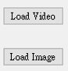
Assignment scoring (Total: 100%)
1. (20%) Background Subtraction
2. (20%) Optical Flow
2.1 (10%) Preprocessing
2.2 (10%) Video tracking
3. (20%) PCA - Dimension Reduction
4. (20%) Training a MNIST Classifier Using VGG19 with BN
4.1 (6%) Load Model and Show Model Structure.
4.2 (6%) Show Training/Validating Accuracy and Loss.
4.3 (8%) Use the Model with Highest Validation Accuracy to Run Inference, Show the Predicted Distribution and Class Label.
5. (20%) Train a Cat-Dog Classifier Using ResNet50
5.1 (4%) Load the dataset and resize images
5.2 (4%) Plot class distribution of training dataset
5.3 (4%) Show the structure of ResNet50 model
5.4 (4%) Improve ResNet50 with Random-Erasing and Compare the accuracies of 2 ResNet50 models on validation dataset
5.5 (4%) Use the trained model to run inference and show the predicted class label
(出題： Chen)
(出題： Jimmy)
* Don’t fix your image and video path
(There is another dataset for demonstration)
Load image and video please use the following function to read the path.
QFileDialog.getOpenFileName
(出題：Zhong)
(出題：Shang)
(出題：Shan)

Slide 5
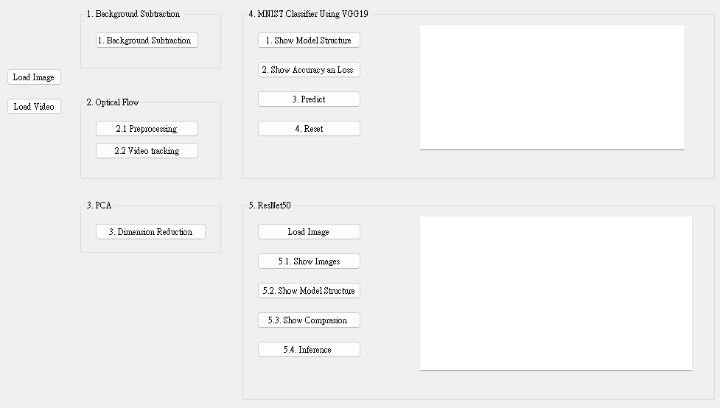
Assignment scoring (Total: 100%)
Use one UI to present 5 questions.

Slide 6
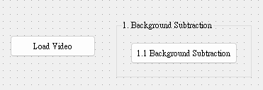
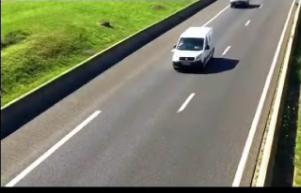
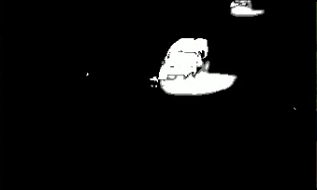
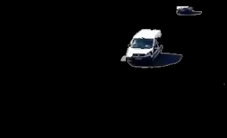
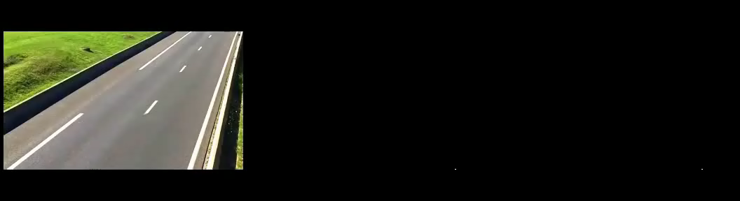
1. Background Subtraction (20%)
(出題：Chen)
Given: a traffic video : “traffic.mp4”
Q: Please remove background and show the result (Result should be like the Demo below)
Load Video from File Dialog
Create subtractor using cv2.createBackgroundSubtractorKNN(history,dist2Threshold,detectShadows=True)
For each frame in video:
3.1) Blur frame using cv2.GaussianBlur(frame, (5, 5), 0)
3.2) Get background mask (M) by subtractor.apply
3.3) Generate Frame (R) with only moving object by cv2.bitwise_and
3.1) ~ 3.2)
3.3)
rgb frame
Foreground mask (M)
Result (R)
Demo (show result when frame number >4)
(M)
(R)

Slide 7
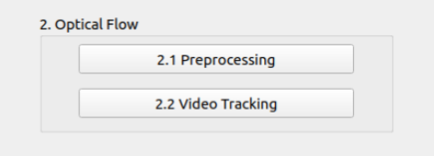
2. (20%) Optical Flow
(出題：Jimmy)
2.1 (10%) Preprocessing
2.2 (10%) Video tracking
UI demo:

Slide 8
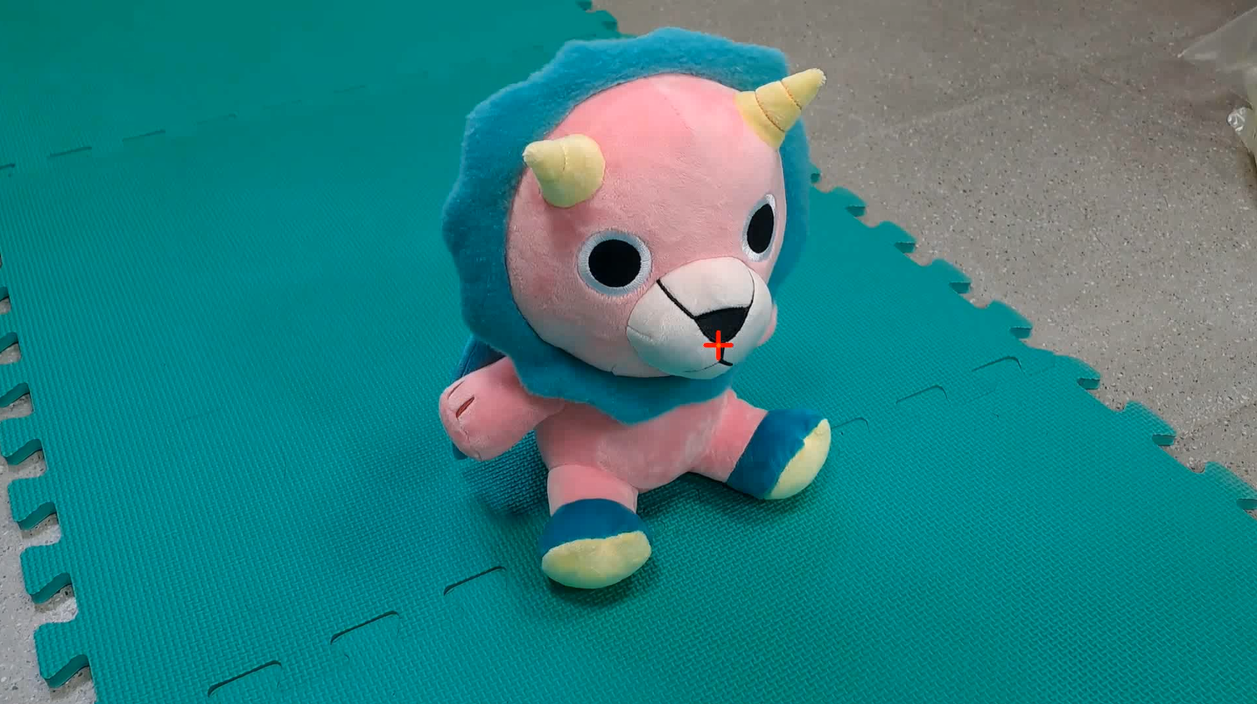
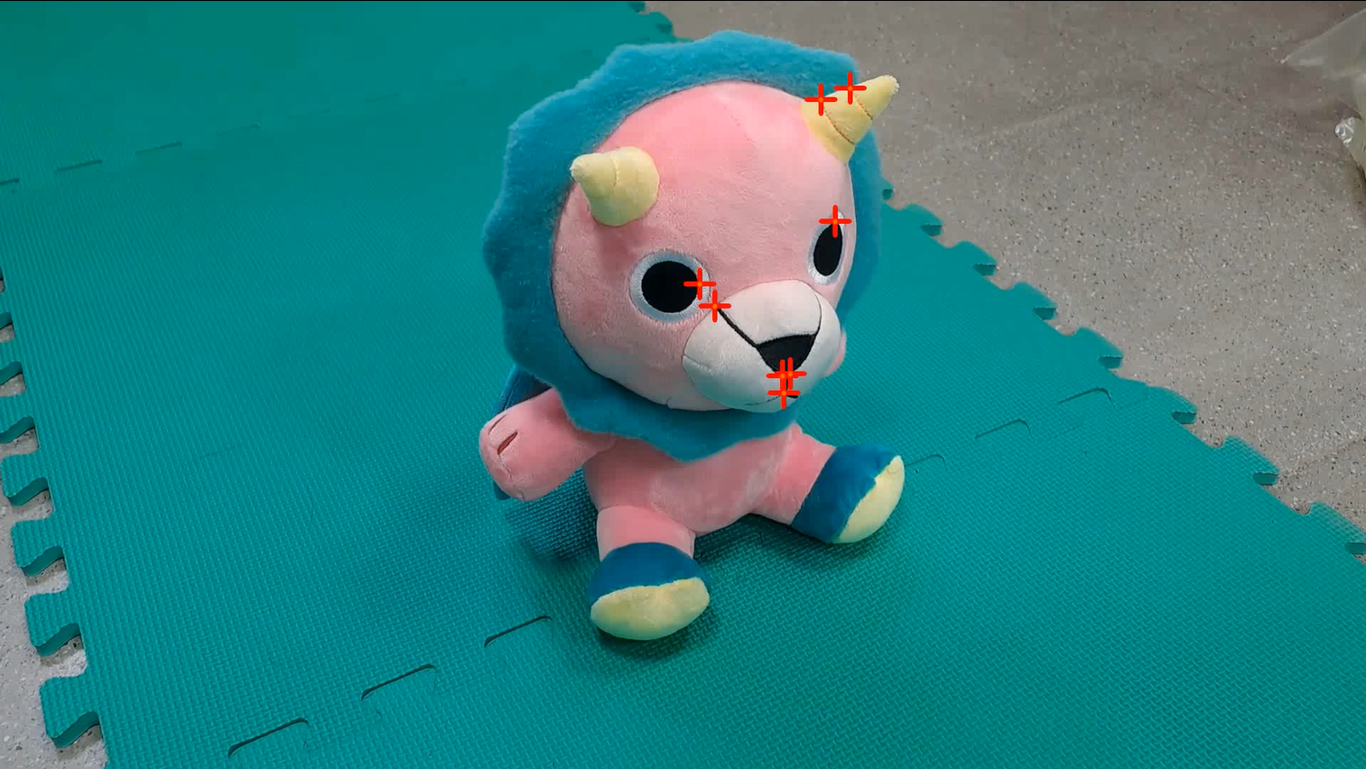
2.1 Preprocessing (10%)
(出題：Jimmy)
Given a video: “optical_flow.mp4”
Q: Click the button 2.1 to detect the point at the bottom of the doll`s nose in 1st Frame using cv2.goodFeaturesToTrack and show the point with a red cross mark using cv2.line
Length: 20px
Parameters in goodFeaturesToTrack should be adjusted:
maxCorners: 1
qualityLevel : 0.3
(quality = min(λ₁, λ₂), λ: eigenvalue from the Hessian matrix)
minDistance: 7
blockSize: 7
Like this
Not this
Thickness: 4px
Point at the bottom of the doll`s nose
False detection points
※ Tip: Draw your own marker with OpenCv functions cv2.line()
(0,0)
x
(0,0)
x
y
y

Slide 9
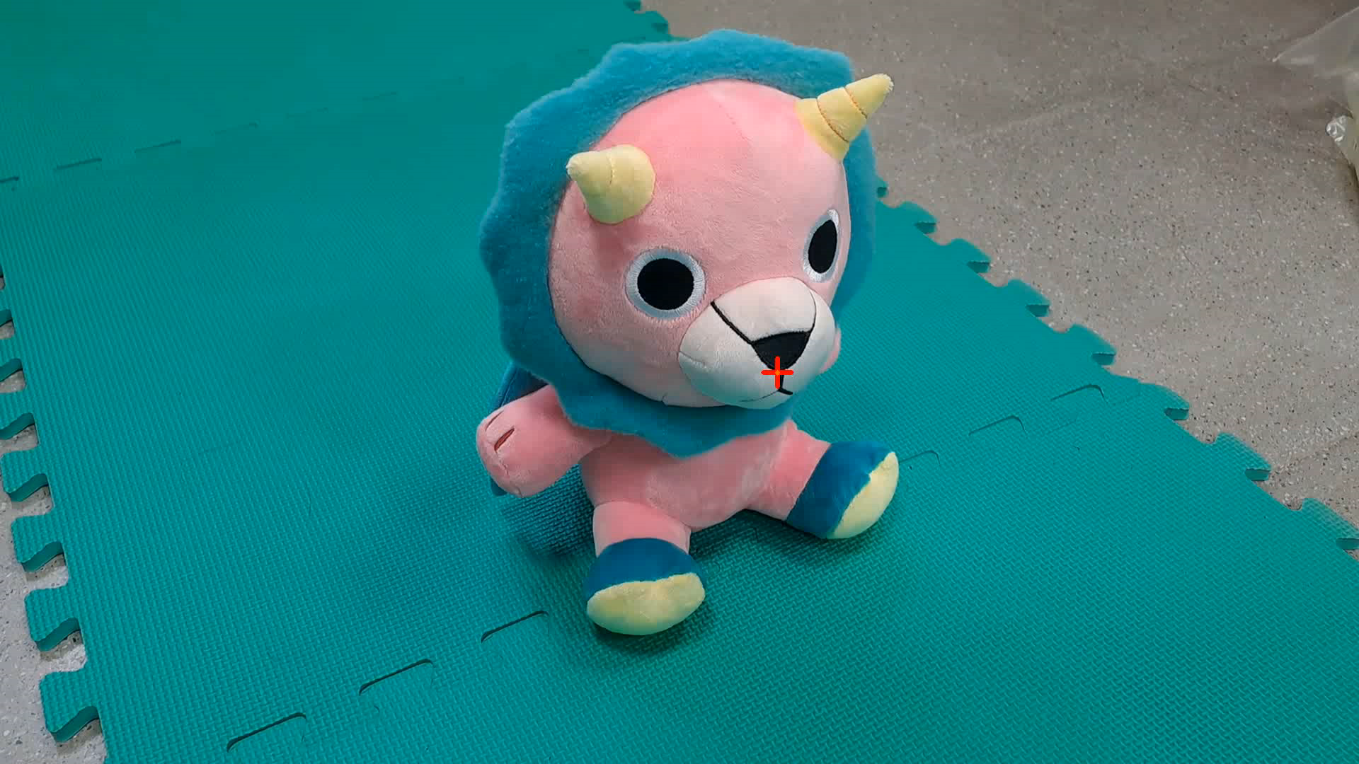
2.2 Video tracking (10%)
(出題：Jimmy)
Q: Click button 2.2 to:
(5%) Track the point (detected in 2.1) on the whole video using OpenCV function cv2.calcOpticalFlowPyrLK.
(5%) Display the trajectory of the tracking point throughout the video using cv2.line. Pick a highly visible color. Ex: Yellow (0,100,255)
Demo videos:
Tool site:
Load video
Optical flow
Optical flow Tutorial

Slide 10

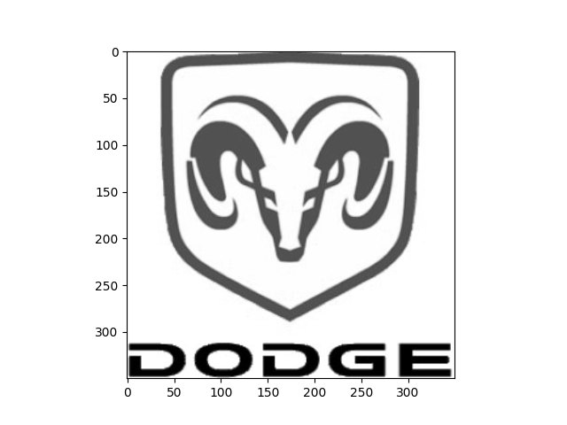
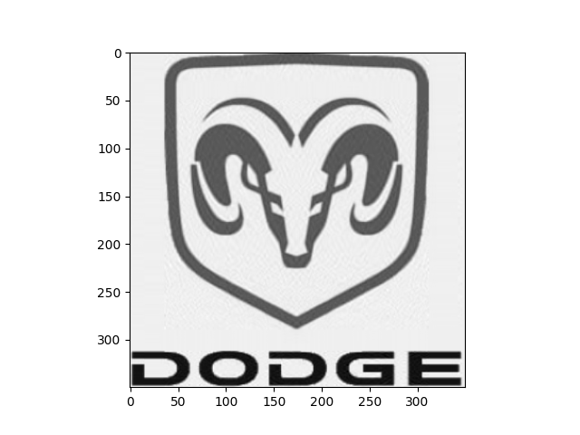
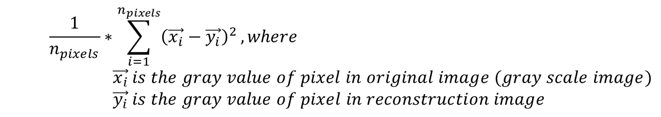
3. (20%) PCA – Dimension Reduction
(出題：Zhong)
Given: A RGB image “logo.jpg”
Q: Using PCA (Principal components analysis) to do dimension reduction on given image, find the minimum components that reconstruction error less or equal to 3.0
Convert RGB image to gray scale image, image shape will be (w,h).
Normalize gray scale image from [0,255] to [0,1]
Use PCA to do dimension reduction from min(w,h) to n, then reconstruct the image.
Use MSE to compute reconstruction error, and find minimum n that error value less or equal to 3.0. Print out the n value. (10%)
Plot the gray scale image and the reconstruction image with n components. (10%)
Hint: Use PCA from python library: sklearn.decomposition
Mean Square Error (MSE) Formula:
$$\frac{1}{n_{pixels}}∗\sum_{i=1}^{n_{pixels}}{{\left(\vec{x_{i}}−\vec{y_{i}}\right)}^{2}}, where \\ \vec{x_{i}} is the gray value of pixel in original image (gray scale image) \\ \vec{y_{i}} is the gray value of pixel in reconstruction image$$
logo.jpg
Gray scale image
Reconstruction image (i.e. n=50)

Slide 11
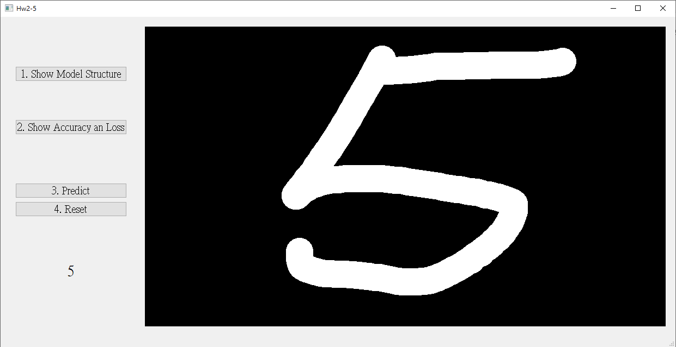
4. Training a MNIST Classifier Using VGG19 with BN (20%)
(出題：Shang)
4.1 Load Model and Show Model Structure. (6%)
4.2 Show Training/Validating Accuracy and Loss. (6%)
4.3 Use the Model with Highest Validation Accuracy to Run Inference, Show the Predicted Distribution and Class Label. (8%)
Figure: GUI example

Slide 12
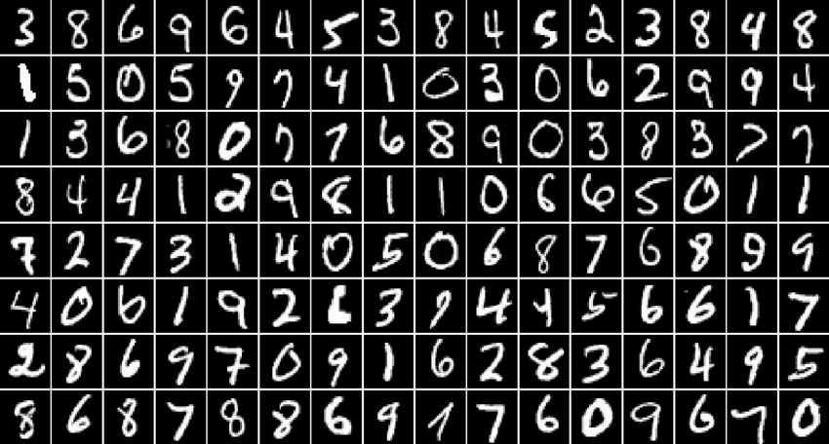
4.0 Training a MNIST Classifier Using VGG19 with BN (20%)
Requirement
Train VGG19 model with batch normalization (BN) using PyTorch.
Download dataset using torchvision.datasets.MNIST() (tutorial)
Training data: 60000 images
Validation data: 10000 images
Resize image to (32, 32)
Parameters
At least 30 epochs.
Cross entropy loss
Adam optimizer
Record training/validation loss and accuracy in .jpg or .png format.
In the submitted file, you need to include
Weight file for VGG19 with BN in .pth format. (File size is approximately 540MB)
Figure of training/validating loss and accuracy in .jpg or .png format.
Code for your GUI program
Code for model training.
Please do not include image data in the submitted file.
(出題：Shang)
R. Reference
VGG19
Batch Normalization

Slide 13
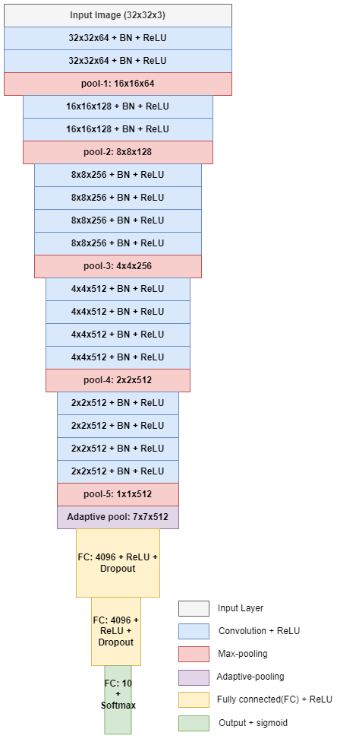
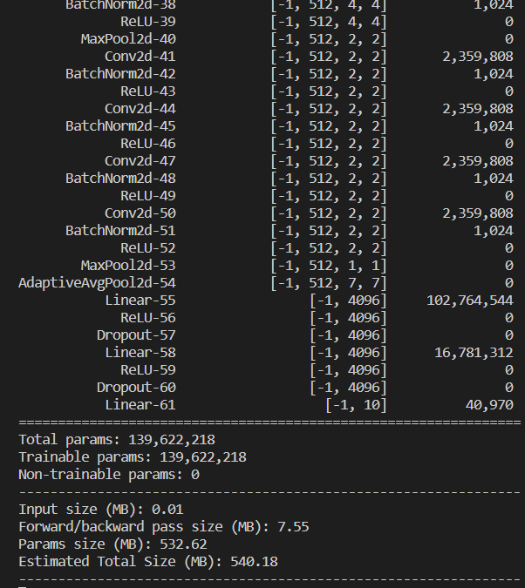
4.1 Show the Structure of VGG19 with BN (6%)
Click the button “1. Show Model Structure”
Show the VGG19 with BN model on terminal using torchsummary.summary().
(出題：Shang)
The -1 indicates that the actual size of batch size can vary.
Feature map shape
(Batch, Channels,
Height, Width)
Layer (type)
Num. of param.
All convolution filter size is 3x3
1. Click the button.
Flatten Here
Figure: the Structure of VGG19 with BN
Figure: VGG19 with BN model structure

Slide 14
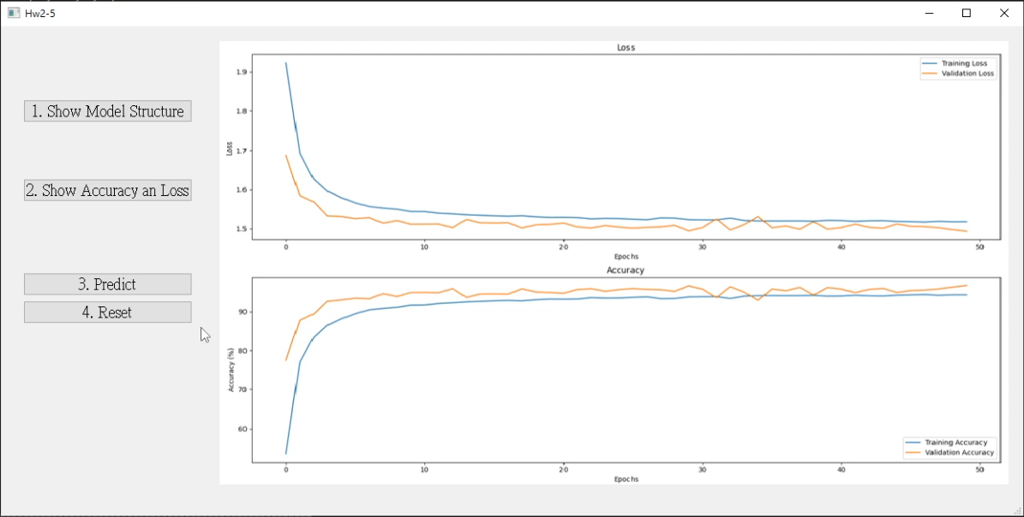
4.2 Show Training/Validating Accuracy and Loss (6%)
At home:
Download the training and validation datasets. (tutorial)
Training and validating VGG19 with BN at least 30 epochs at home (tutorial) and record the training/validating accuracy and loss in each epoch (tutorial).
If your validation accuracy is low, you can try
Adjust the learning rate of the optimizer.
Change the data augmentation techniques used.
Save weight file with highest validation accuracy .
Use matplotlib.pyplot.plot() to create a line chart for the training and validating loss and accuracy values and save the figure.
When the demo:
Click the button “2. Show Accuracy and Loss”
Show the saved figure of Training/Validating loss and accuracy in a new window
(出題：Shang)
(2) Show the figure in a new window
(1) Click the button.
Notice: this is an example, the number of epoch might differ

Slide 15
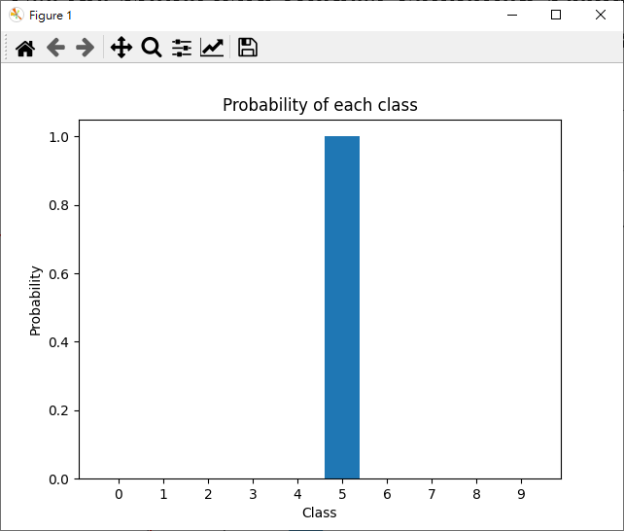
4.3 Use the Model with Highest Validation Accuracy to Run Inference, Show the Predicted Distribution and Class Label. (8%)
(出題：Shang)
Load the model with highest validation accuracy which trained at home.
Draw a number on graffiti board using mouse. (tutorial)
Background: black
Pen: white
Click the button “3. Predict” to run inference on the image you drew.
Show the predicted class label on the GUI.
Show the probability distribution of model predictions using a histogram in a new window.
Click the button “4. reset” to clear the graffiti board.
2.
3. Probability of each class
3.
4.
3. Predicted class

Slide 16

4.3 Use the Model with Highest Validation Accuracy to Run Inference, Show the Predicted Distribution and Class Label. (6%)
(出題：Shang)
The probability distribution of model prediction using a histogram.
Y-axis: probability
X-axis: class name

Slide 17
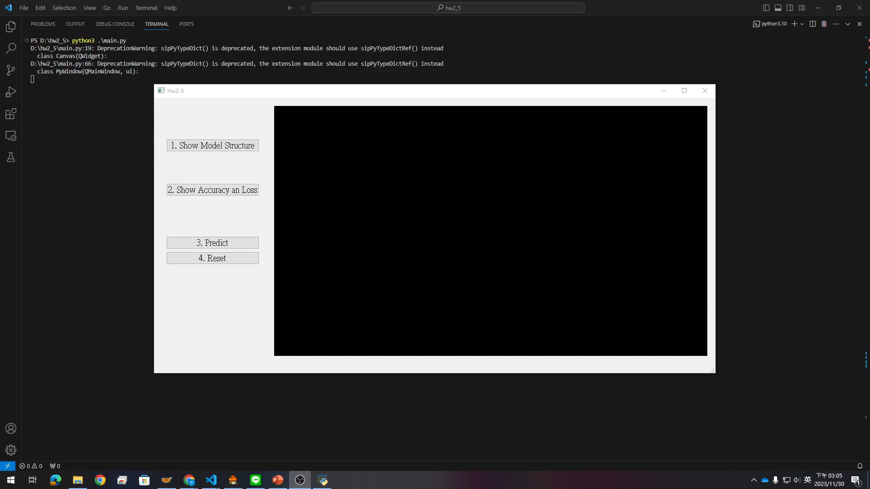
4. Training a MNIST Classifier Using VGG19 – Example Video
(出題：Shang)
This is an example illustrating the objectives from 4.1 ~ 4.3.

Slide 18
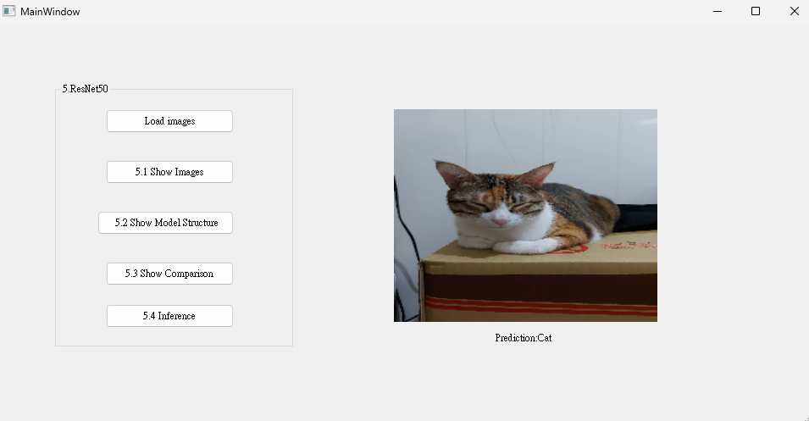
5. Train a Cat-Dog Classifier Using ResNet50 (20%)
(出題：Shan)
5.1 (5%) Load the dataset and resize images
5.2 (5%) Show the structure of ResNet50 model
5.3 (5%) Improve ResNet50 with Random-Erasing and Compare the accuracies of 2 ResNet50 models on validation dataset
5.4 (5%) Use the trained model to run inference and show the predicted class label
Figure: GUI Example

Slide 19
Objective
Learn how to train a ResNet50 model to classify images of cats and dogs using PyTorch (tutorial)
Download Cats and Dogs Dataset from FTP
Data type: JPG images
2 classes: Cat and Dog
Datasets
Training dataset: 16,200 JPG images in total.
Validation dataset: 1,800 JPG images in total.
Inference dataset: 10 JPG images in total. It is for testing the inference function in your GUI program.
5.0 Train a Cat-Dog Classifier Using ResNet50
(出題： Shan)
3. In the submitted file
Organize the files in this structure:
Hw2_StudentID_Name_Version // project folder
|-- model // folder to put trained models
|-- inference_dataset
|-- Cat
|-- Dog
|-- main.py // codes for your GUI program
|-- train.py // codes for model training
|-- ⁞ // other files or folders you need
Notice: Please include the inference dataset in your homework file.
R. Reference
Deep Residual Learning for Image Recognition
Kaggle Cats and Dogs Dataset

Slide 20
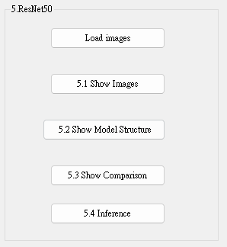
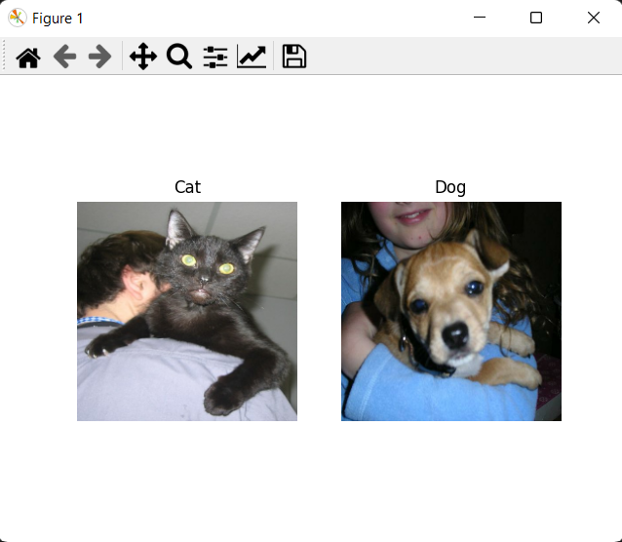
5.1 (5%) Load the dataset and resize images
(出題： Shan)
At home:
Load the inference dataset
→ Hint:
(a) PyTorch (tutorial): torch.utils.data.Dataset
Resize images to 224×224×3c (RGB)
→ Hint:
(a) PyTorch (tutorial): torchvision.transform
(3) Click the button “1. Show Images”
(4) Get 1 image from each class in the inference dataset
(5) Show images in a new window
→ Hint: use matplotlib.pyplot functions to show images (tutorial):
(a) figure()
(b) imshow()
(c) subplot()
(d) title()
When the demo:
Click the button “1. Show Images”
Show images in a new window
Figure: 1 image from each class
Notice: this is an example, the images might differ

Slide 21
5.2 (5%) Show the structure of ResNet50 model
(出題： Shan)
At home:
Build a ResNet50 model
→ Hint:
(a) PyTorch: torchvision.models.resnet50()
with a Sigmoid activation functionReplace the output layer to a FC (Fully Connected) layer of 1 node
→ Hint:
(a) PyTorch (tutorial): torch.nn.Linear(2048, 1), torch.nn.Sigmoid
If the class label of Cat is 1, the output value (range: 0 ~ 1) should be close to 1 for cat images, and vice versa.
Run the function to show the structure in the terminal
→ Hint:
(a) PyTorch: torchsummary
When the demo:
Click the button “3. Show Model Structure”
Run the function to show the structure in the terminal

Slide 22
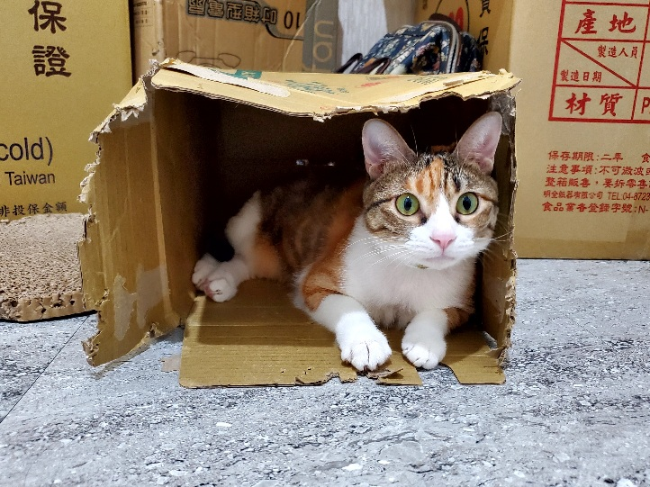
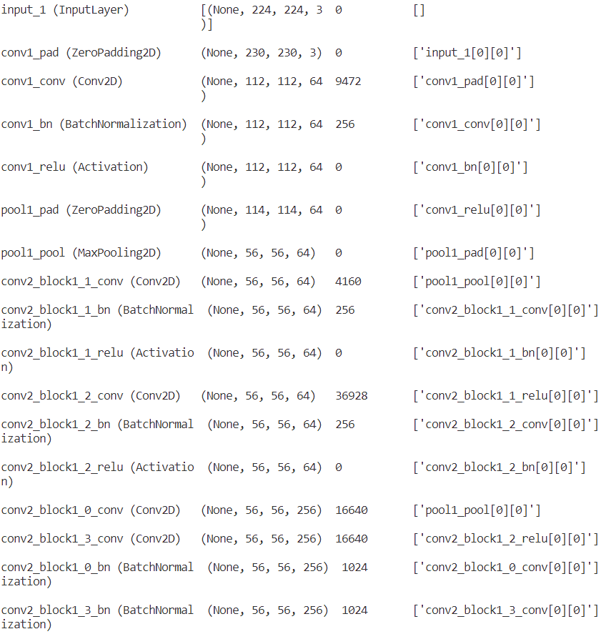
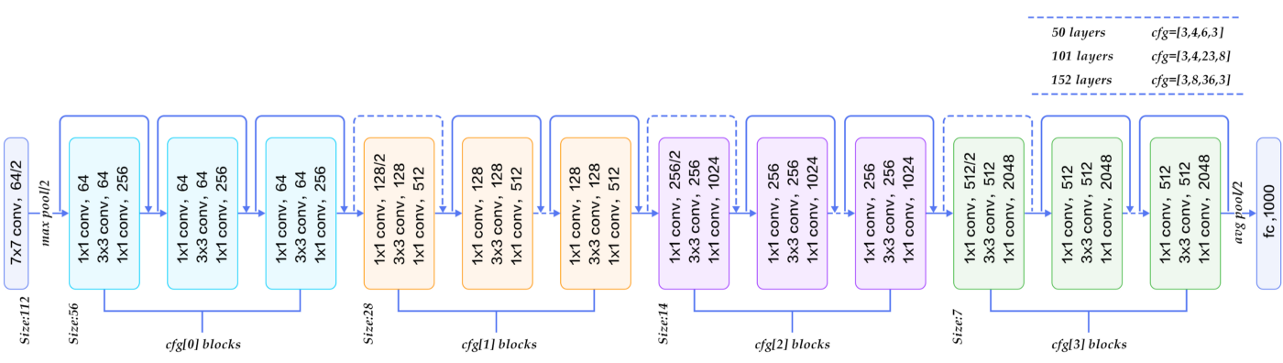
5.2 (5%) Show the structure of ResNet50 model
(出題： Shan)
Input: an RGB image 224×224×3c
Feature map shape
(B, H, W, C)
Num. of param.
Layer (type)
Layer connecting to
112×112×64c
3×3
/2: stride = 2
56×56×256c
×3
Every conv layer is followed by a BN layer and a ReLU layer
28×28×512c
×3
BN: Batch Normalization
ReLU: Rectified Linear Unit
×5
14×14×1024c
×2
7×7×2048c
global avg pool
FC, 1c
FC: fully connected
Figure: the structure of ResNet50 model
Output: a confidence value (range: 0 ~ 1)

Slide 23
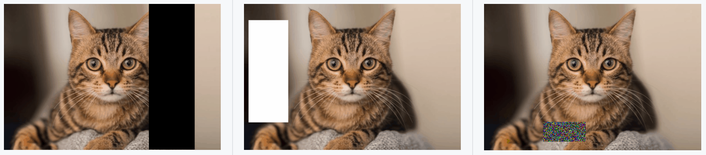
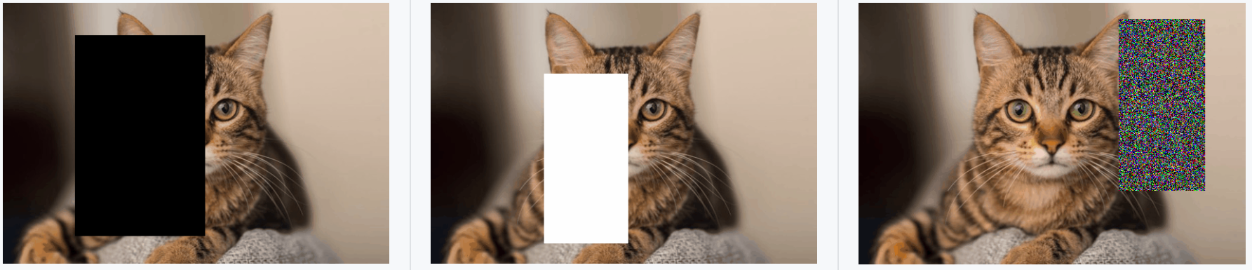
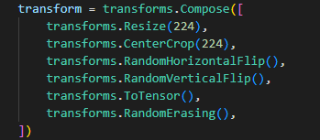
5.3 (5%) Improve ResNet50 with Random-Erasing
(出題： Shan)
At home: Set up Random-Erasing in codes for model training (train.py)
Train 2 ResNet50 models with training dataset
→ Hint:(a) PyTorch (tutorial): write a for loop to validate the model
(a) With Random-Erasing
(b) Without Random-Erasing
2) When the demo: Show your codes about Random-Erasing in train.py
Figure1: Examples of the use of Random-Erasing
R. Reference
Random Erasing Data Augmentation

Slide 24
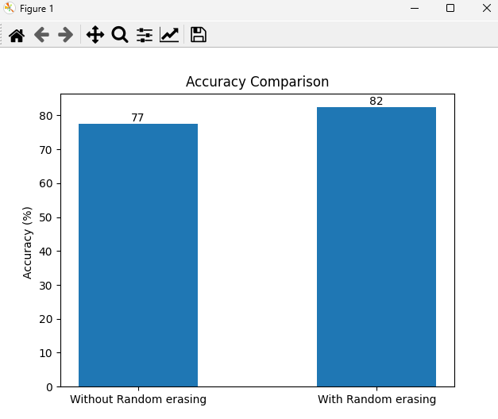
5.3 (5%) Compare the accuracies of 2 ResNet50 models on validation dataset
(出題： Shan)
At home:
Validate 2 ResNet50 models with validation dataset
→ Hint:
(a) PyTorch (tutorial): write a for loop to validate the model
Plot the accuracy values with a bar chart
Save the figure
When the demo:
Click the button “4. Show Comparison”
Show the saved figure of accuracy comparison in a new window
Figure1: Accuracy Comparison
Notice: this is an example, the numbers might differ

Slide 25
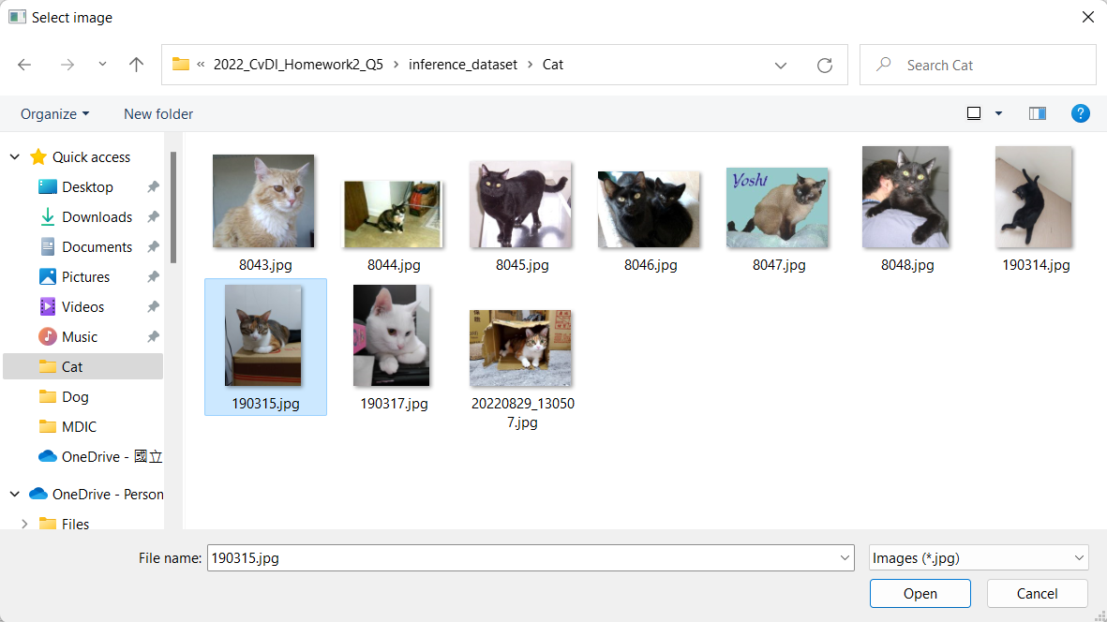
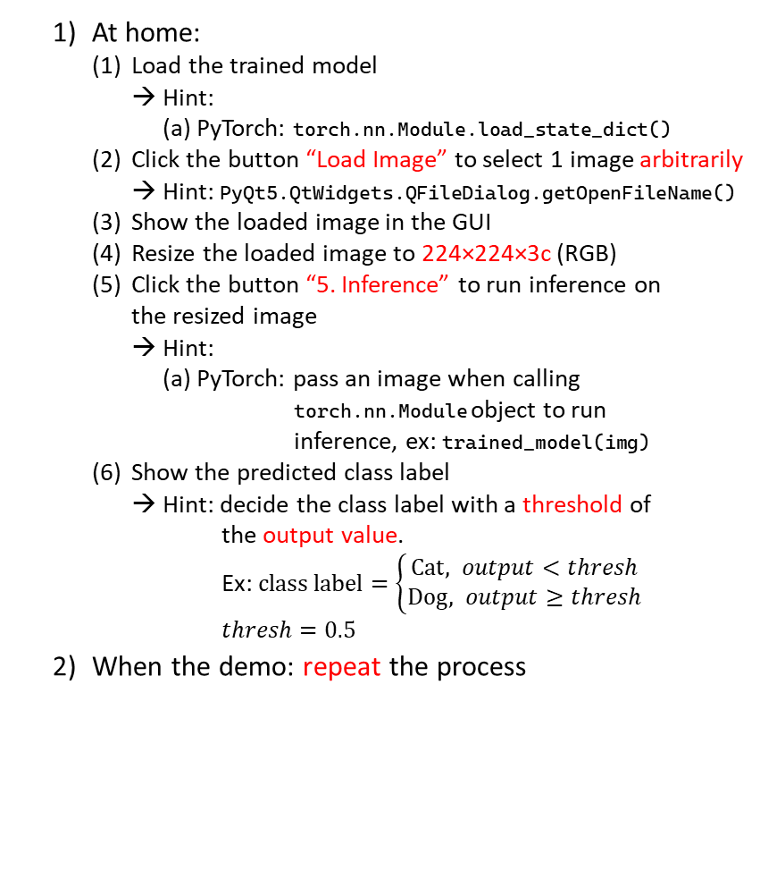
5.4 (5%) Use the better-trained model to run inference and show the predicted class label
(出題： Shan)
At home:
Load the trained model
→ Hint:
(a) PyTorch: torch.nn.Module.load_state_dict()
Click the button “Load Image” to select 1 image arbitrarily
→ Hint: PyQt5.QtWidgets.QFileDialog.getOpenFileName()
Show the loaded image in the GUI
Resize the loaded image to 224×224×3c (RGB)
Click the button “5. Inference” to run inference on the resized image
→ Hint:
(a) PyTorch: pass an image when calling torch.nn.Module object to run inference, ex: trained_model(img)
Show the predicted class label
→ Hint: decide the class label with a threshold of the output value. Ex: $class label=\left\{\begin{aligned}Cat, output<thresh \\ &Dog, output≥thresh\end{aligned}\right.$
$$thresh=0.5$$
When the demo: repeat the process
(2) Select 1 image arbitrarily
(3) Show the loaded image
(4) Resize the loaded image to 224×224×3c
(1) Click the button
(5) Run inference on the loaded image
(6) Show the predicted class label

Slide 26
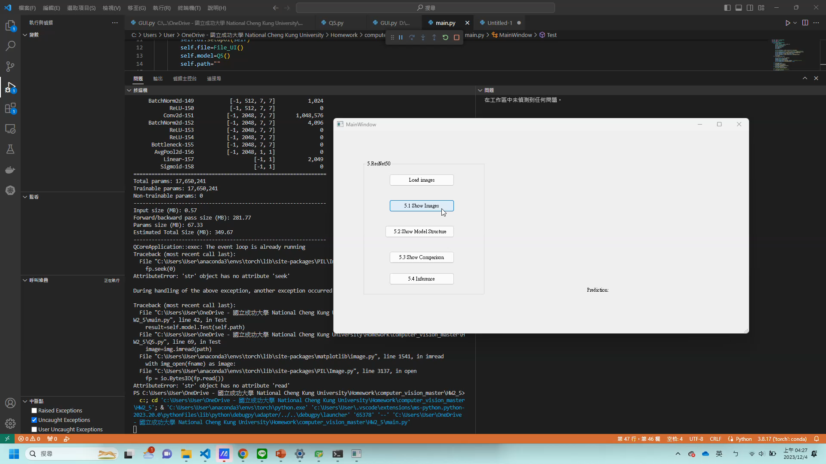
5. Train a Cat-Dog Classifier Using ResNet50 – Demo Video
This is an example illustrating the objectives from 5.1 ~ 5..

